Slide 1



LPG Day 2024
Communication Toolkit
#LPGday – 7 June 2024
WLGA website version

Slide 2
Why? LPG Day
    LPG Day is the annual global awareness day to celebrate LPG around the world, and to raise awareness of the benefits of LPG beyond the industry itself.
    LPG Day is about celebrating LPG as a product, showcasing how it improves lives around the world and its integral role in the energy transition.
    LPG Day also celebrates the people behind LPG, whether as part of the supply chain or as LPG users.
How? Celebrate LPG Day 2024
    Everyone is welcome to celebrate LPG Day!
    The following slides provide sample ideas, message suggestions and a customisable visual to help celebrate LPG Day by joining the global conversation online.
    We welcome you to share your message far and wide using email, websites, newsletters, social media or maybe even on your local radio.
Official hashtag
The official social media hashtag for is #LPGday
Include this hashtag in any content you share on
social media.
Save the date!
Click to add LPG Day as reminder to your calendar for Friday 7th June
ICalendar

Slide 3
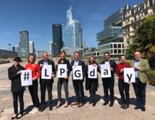
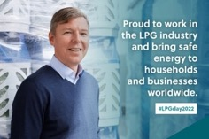
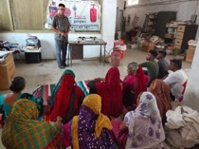
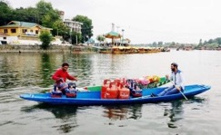

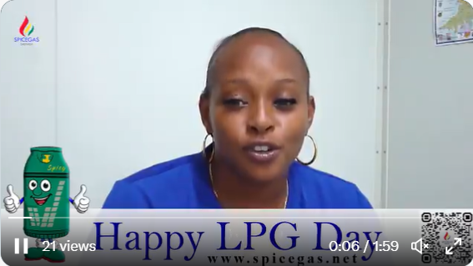
CREATIVE IDEAS TO CELEBRATE AT WORK, AT HOME, OR ONLINE
Team photo | Proud to work… | Organise events
Create a LPG Day sign with colleagues and take a photo in front of a local landmark. | Explain why you are proud to work in the LPG industry. | Organise events to raise awareness of the uses and benefits of LPG.
Explore with LPG | Personal video | Encourage others!
Find and share photos of people using LPG around the world. | Record a personal “Happy LPG Day!” video. Share your LPG story. | Share how you will be celebrating LPG Day and encourage others to join.

Slide 4
Suggested Messages
    Help us spread the word
    #LPG accounts for about 3% of #energy consumed globally and is used by more than 3 billion people on all continents🌍LPG is an exceptional energy – let's celebrate it worldwide on 7 June - use #LPGday🥳
    Want to learn more? www.worldliquidgas.org
    Every single country in the world already consumes #LPG in a wide range of applications. LPG and #renewable #LiquidGas provide accessible & reliable energy anywhere on the planet today🌍
    Let's celebrate this exceptional #energy on 7 June for #LPGday www.worldliquidgas.org/what-is-lpg-day
    Participate on LPG Day
    Happy #LPGday 2024! 🥳
    Join us and @WorldLiquidGas in celebrating #LPG. LPG is clean-burning, low-carbon and with the development of renewable #LiquidGas, can provide #NetZero energy solutions to billions of people across the planet.
    Find out more www.worldliquidgas.org
Hashtags
Please include #LPGday in any content you share.
Best additional hashtags to also use on social media:
#LPG; #LiquidGas; #AlternativeFuel; #Autogas
#CookingFuel; #EnergyTransition; #EnergyEfficiency

Slide 5

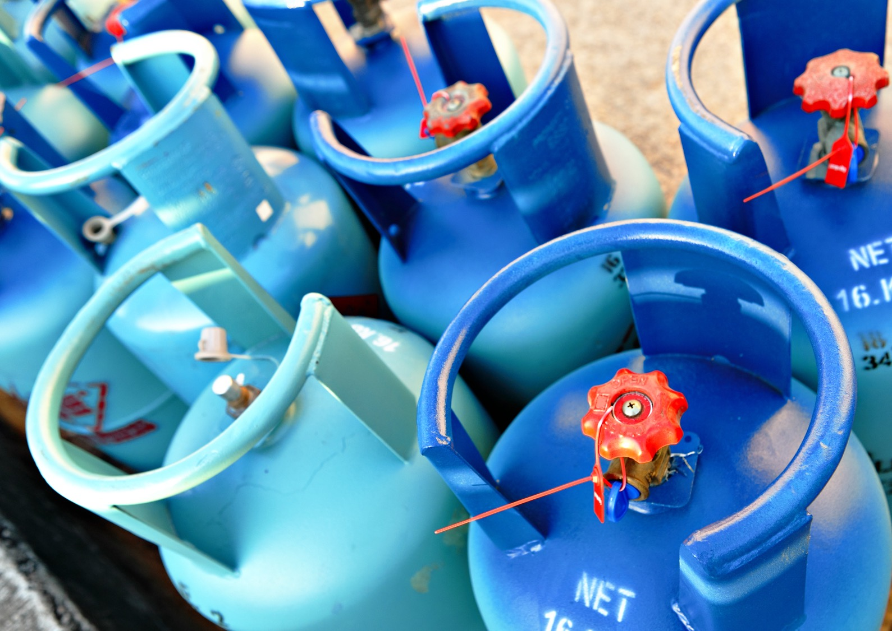

^{7 June 2024}
Happy
LPG Day
#LPGday

Slide 6

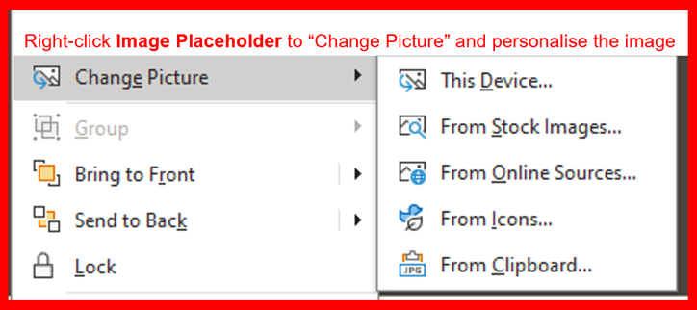
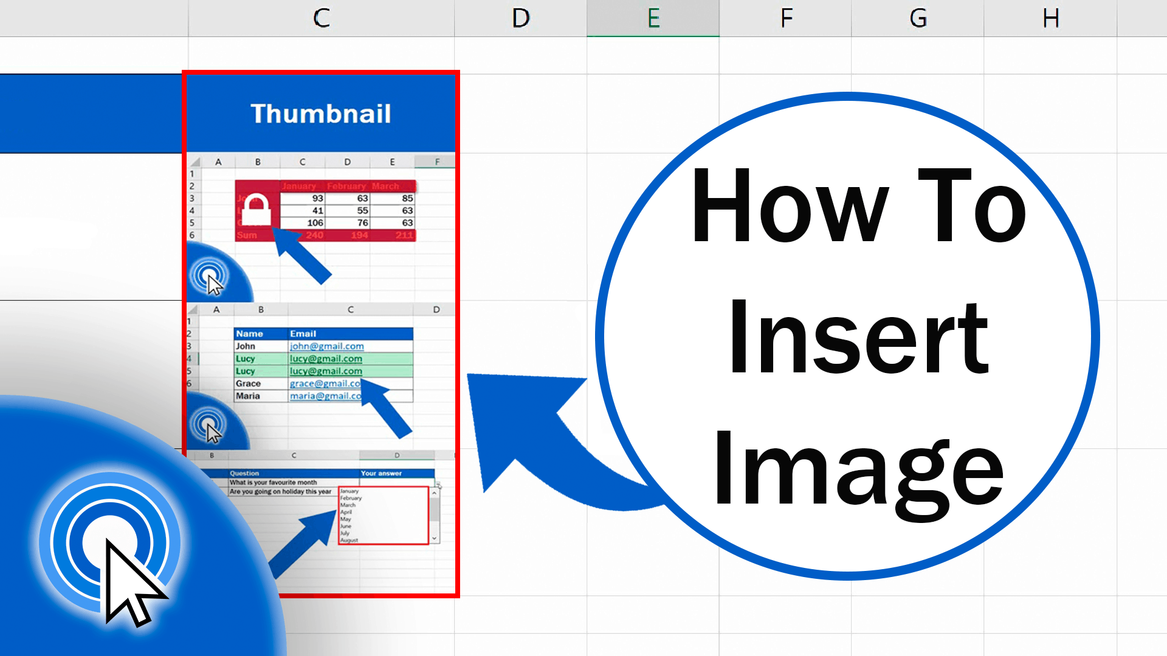
^{7 June 2024}
Celebrating
LPG Day
#LPGday

Slide 7
Where? Social Media
    WLGA will be sharing a range of content in advance of LPG Day, as well as on the day itself (Friday 7 June), make sure you’re following the relevant WLGA channels so you can see, share the latest #LPGday updates and join the online conversation. Help us spread the word!
    Follow us and tag us in posts on social media:
    Twitter: @WorldLiquidGas
    LinkedIn: @WorldLiquidGasAssociation
    Facebook: @WorldLiquidGasAssociation
    Instagram: @worldliquidgasassociation
Learn more: LPG Day Webpage
Looking for more information or inspiration?
We have created a dedicated webpage for LPG Day 2024.
    For more information about LPG Day and how to get involved this year: What is LPG Day?
More general information about LPG is also available:
    Why use LPG? Why use LPG
    Where is LPG used? Where is LPG used?

Slide 8
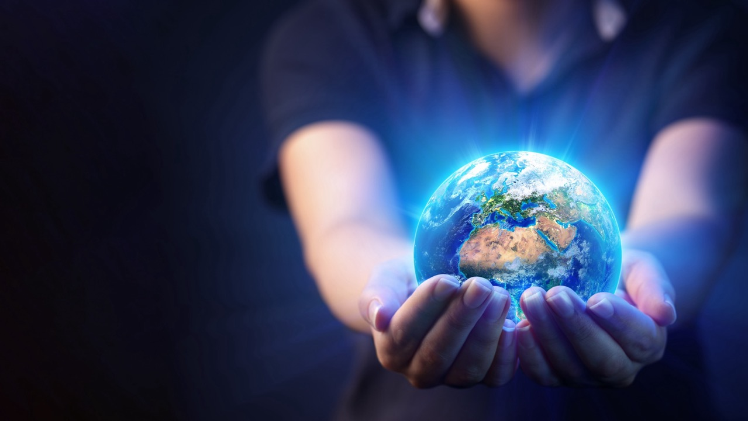



Happy
LPG Day!
182, avenue Charles de Gaulle
92200 Neuilly-sur-Seine, France
Tel.: +33 (0)1 78 99 13 30
Email: association@worldliquidgas.org
www.worldliquidgas.org

